Slide 1

Project One
Starting Lineup:
Point Guard – Enyo
Power Forward – Ric
Center - Welchman

Slide 2

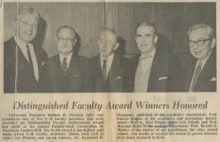



Slide 3
“Good teams win; Great teams cover.”
Ancient Klingon Proverb

Slide 4
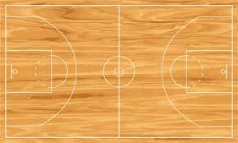
What is Basketball?
Merriam-Webster defines basketball as…

Slide 5
What is Basketball?
Wikipedia defines basketball as…

Slide 6
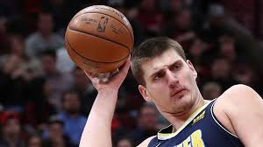
lol his nickname is joker lmao

Slide 7
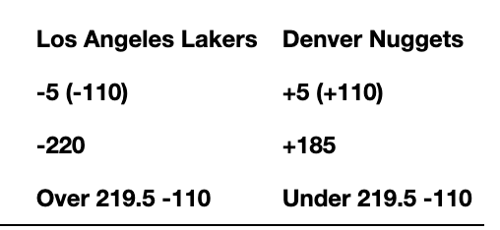
Gambling 101 (or An Introduction into Degeneracy)
Spread
Money line
Over/Under

